Slide 1
The Marketing Plan

Slide 2
Economics
Facts about your industry:
What is the total size of your market?
What percent share of the market will you have?
Current demand in target market
Trends in target market
Growth potential and opportunity for a business of your size

Slide 3
Economics
Barriers to entry - Some typical ones are:
High capital costs
High production costs
High marketing costs
Consumer acceptance/brand recognition
Training/skills
HOW WILL YOU OVERCOME THEM?

Slide 4
Economics
How could the following affect your company?
Change in technology (Ex. VoIP)
Government regulations
Changing economy
Change in your industry

Slide 5
Products
Features and Benefits
Describe the most important features. That is, what will the product do for the customer? What is special about it?
Describe its benefits. That is, what will the product do for the customer?
Ex. Fortified with Vitamin C, Pride detergent

Slide 6
Customers
Identify your targeted customers, their characteristics, and their geographic locations; i.e., demographics.

Slide 7
Customers
Demographic Profile of consumer group:
Age
Gender
Location
Income level
Social class/occupation
Education

Slide 8
Customers
Demographic Profile of business customers:
Location
Size of firm
Quality/technology/price preferences
Others (specific to your industry)

Slide 9
Competition
List your major competitors
Will you have important indirect competitors?
How will your products/services compare with the competition?
What is the value of the competitive matrix to you?

Slide 10
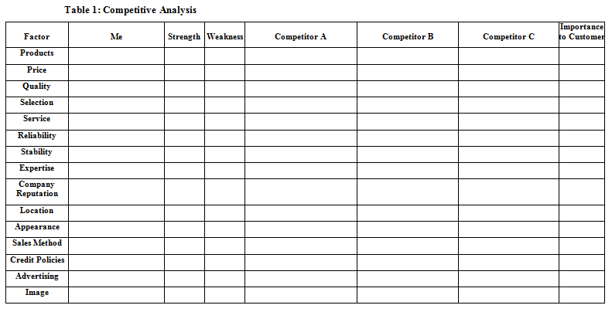

Slide 11
Niche
Now that you have systematically analyzed your industry, your product, your customers and the competition, you should have a clear picture or where your company fits into the world.
Define your niche, your unique corner of the market.
Ex. shampoo

Slide 12
Strategy
Promotion (how? Type of ads, etc.)
Promotional Budget (how much? Ex. Silka)
Pricing
Proposed Location
Distribution Channels
Note: “guerilla marketing”

Slide 13
Sales Forecast
Twelve-Month Sales Forecast Spreadsheet

